Slide 1

Medical Imaging Informatics
Maruf Adewole, PhD
Medical Artificial Intelligence Laboratory
Lagos, Nigeria

Slide 2
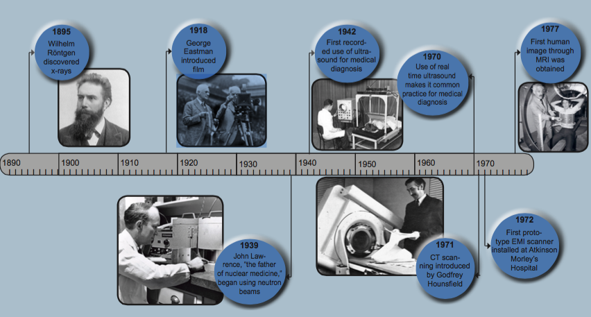
Radiology Timeline
https://www.purview.net

Slide 3
Medical Image Reconstruction
Imaging Modality | Image Reconstruction Technique
CT | Filtered Back Projection (FBP), Iterative Reconstruction (IR)
MRI | Fourier Transform (FT) & Inverse Fourier Transform (IFT), Compressed Sensing (CS)
USS | Beamforming & Signal Processing
PET | Maximum Likelihood Expectation Maximization (MLEM), Ordered Subset Expectation Maximization (OSEM)
SPECT | Filtered Back Projection (FBP), Iterative Reconstruction (IR)
Optical Imaging | Inverse Scattering & Tomographic Algorithms
Conversion of information obtained from Medical Imaging devices to readable format

Slide 4
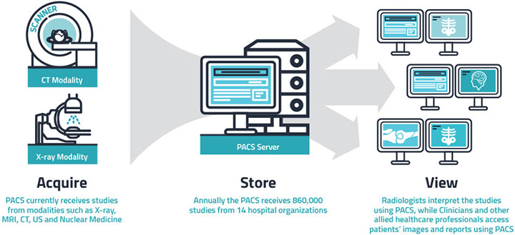
Medical Imaging Informatics
Enhanced Diagnosis
Improved Workflow
Patient Centered Care
Data driven insights
Cost effectiveness

Slide 5
Key Components
Picture Archiving and Communication Systems (PACS)
Radiology Information Systems (RIS)
Electronic Health Records (EHR)
Artificial Intelligence (AI) in Imaging Informatics
Cloud Based solutions

Slide 6
Standards, Formats and Regulations
Standards
HL7
FHIR
Formats
DICOM
NIFTI
MNC
JPG/PNG
Regulations
HIPAA
GDPR

Slide 7
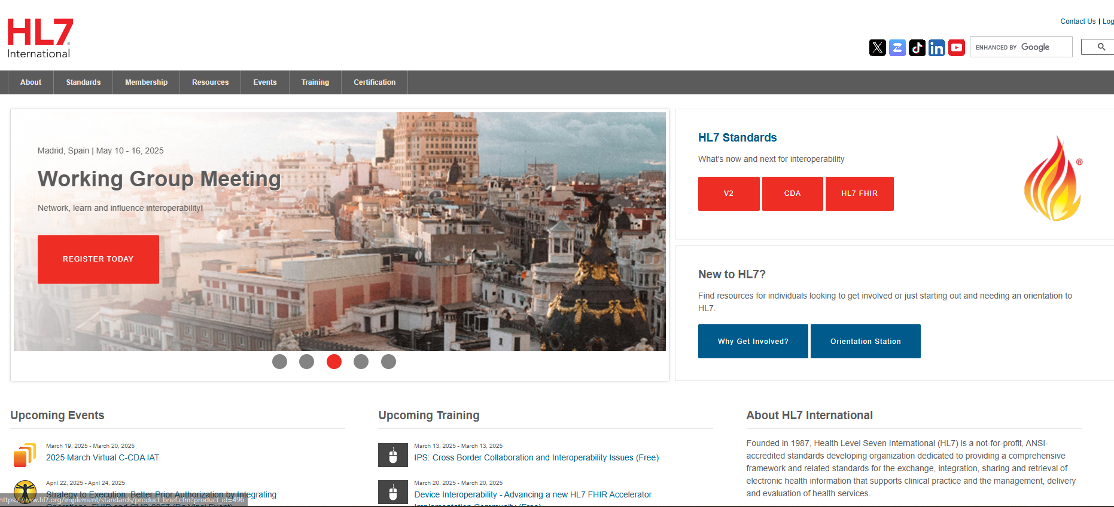
Health Level Seven International - Set of international standards for the exchange, integration, sharing, and retrieval of electronic health information founded in 1987

Slide 8
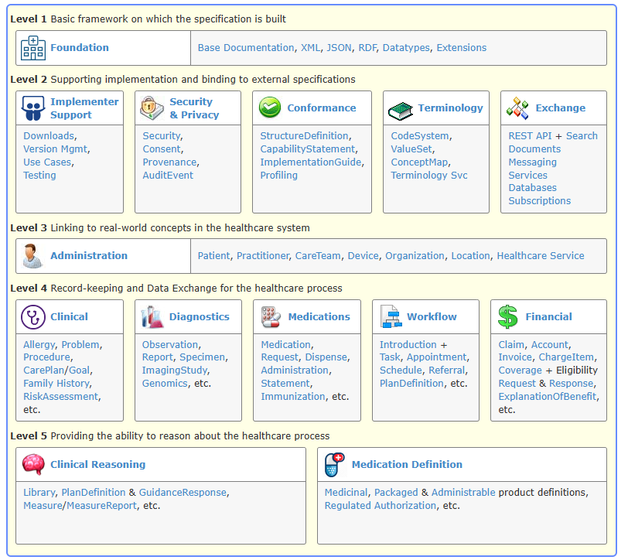
FHIR
Fast Healthcare Interoperability Resources - Standard developed by HL7 that provides a flexible, web-based approach for healthcare data exchange.

Slide 9
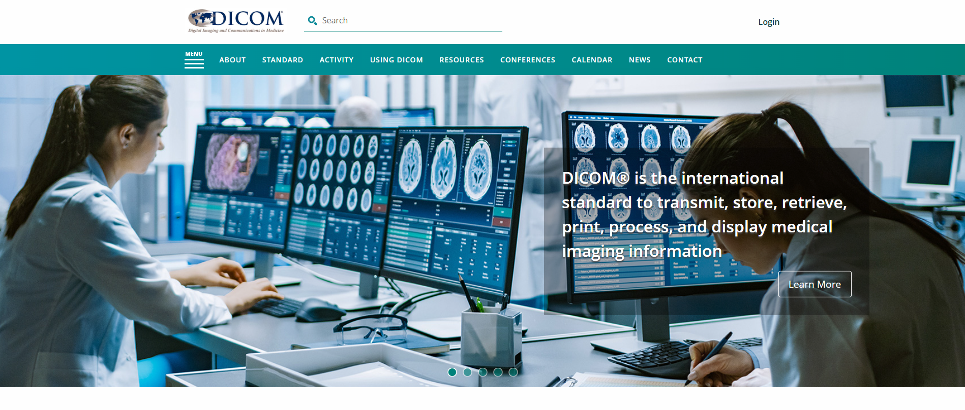
Format for storing, sharing, and transmitting medical imaging data that ensures imaging data retains necessary metadata

Slide 10
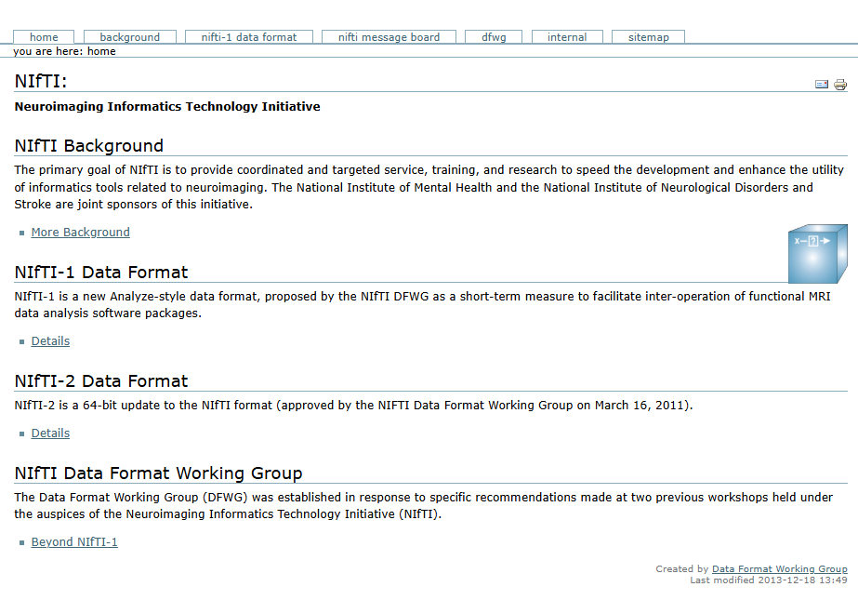

Slide 11
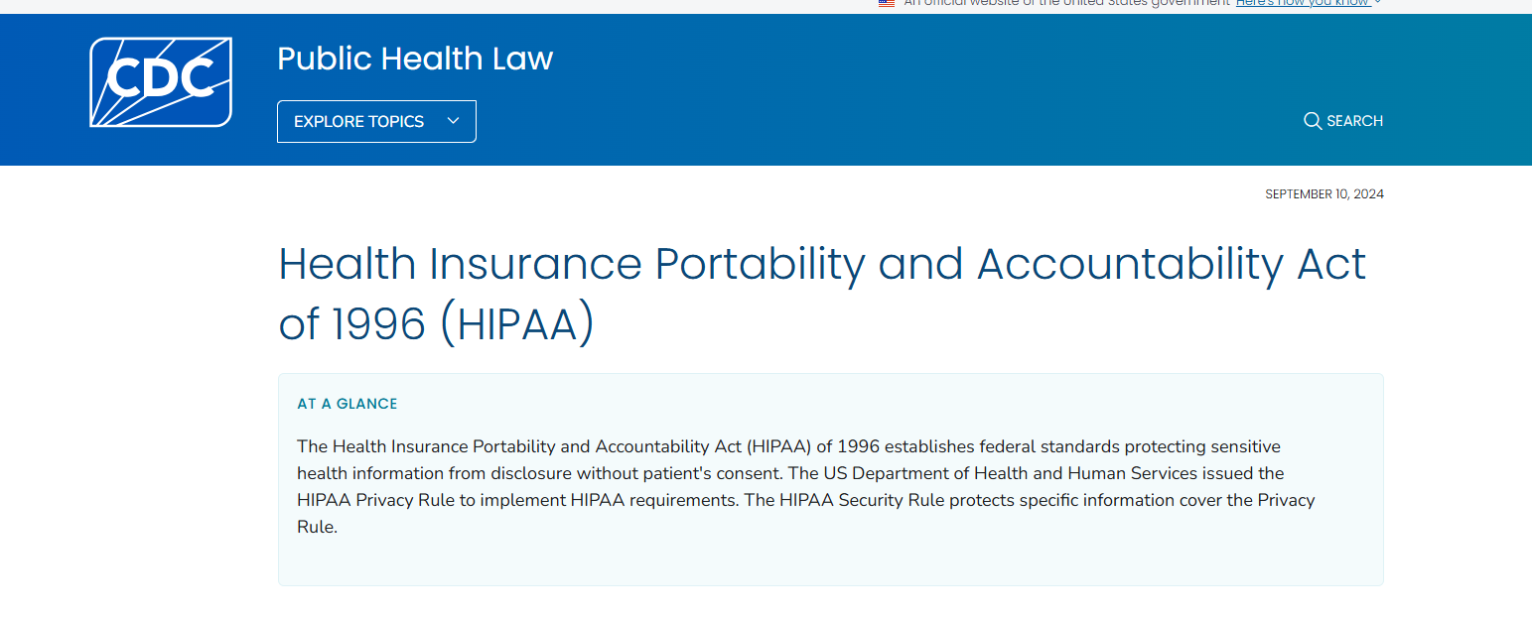
HIPAA (Health Insurance Portability and Accountability Act - USA) Requires patient data protection, encryption, and controlled access when handling medical images and AI models.

Slide 12
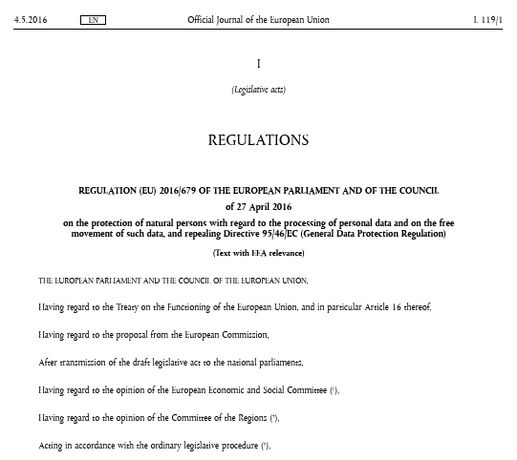
GDPR
GDPR (General Data Protection Regulation - EU)
Governs the protection of personal data, including medical images, in the EU

Slide 13

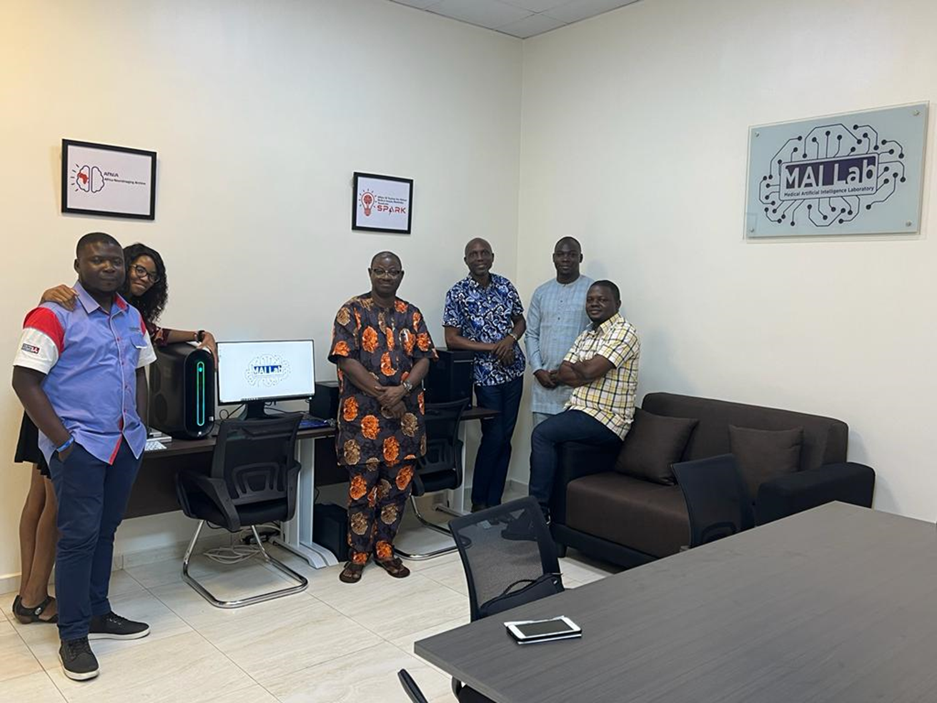
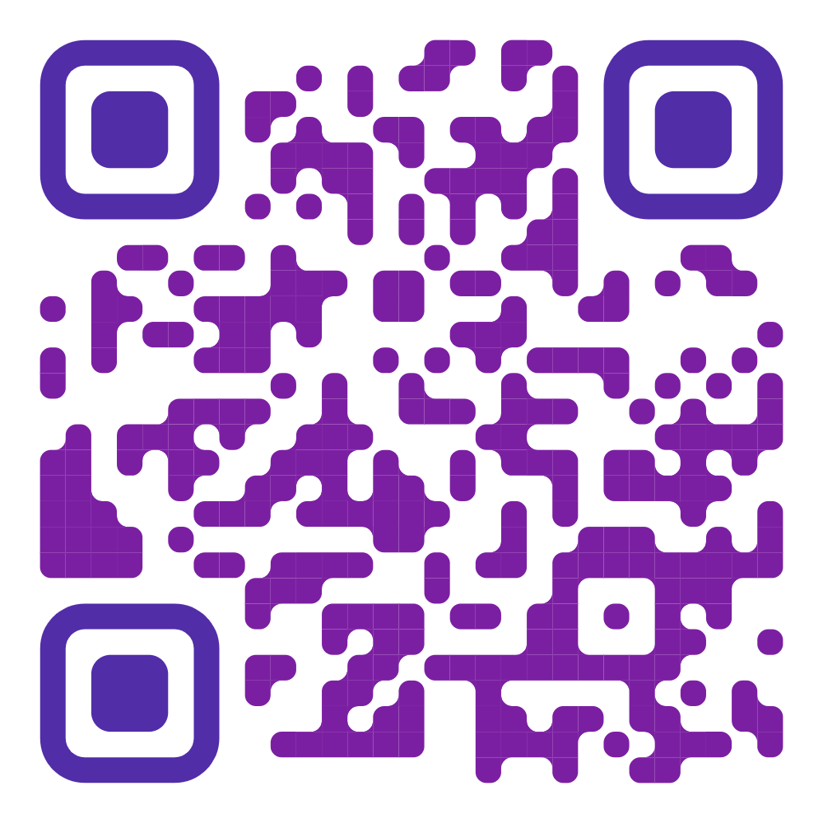


Thank You!
@Mailab_io https://www.mailab.io
Email: madewole@mailab.io

